Slide 1

Chapter 17 Trees, Heaps, and Priority Queues

Slide 2
Objectives
To represent and access the elements in a binary tree (§§17.2.1-17.2.2).
To insert an element to a binary tree (§17.2.3).
To traverse a binary tree in inorder, postorder, and preorder (§17.2.4).
To define a binary tree class (§17.2.5).
To know the properties of a heap (§17.3).
To know how to add and remove elements from a heap (§§17.3.2-17.3.3).
To implement a heap using a vector (§17.3.4).
To implement a priority queue using a heap (§17.4).

Slide 3
Binary Trees
A list, stack, or queue is a linear structure that consists of a sequence of elements. A binary tree is a hierarchical structure. It is either empty or consists of an element, called the root, and two distinct binary trees, called the left subtree and right subtree. Examples of binary trees are shown in Figure 17.1.

Slide 4
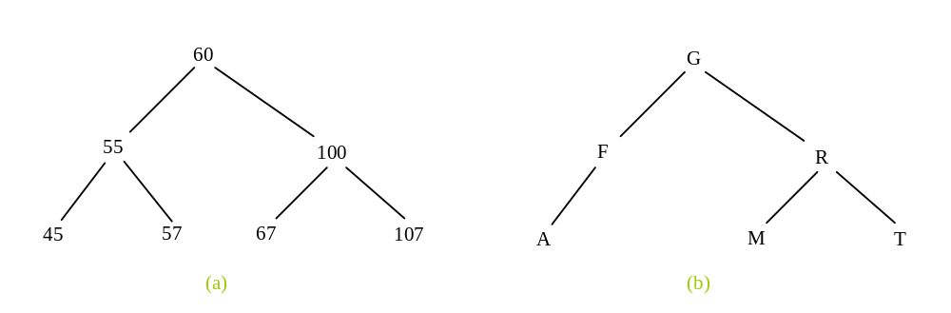
Binary Tree

Slide 5
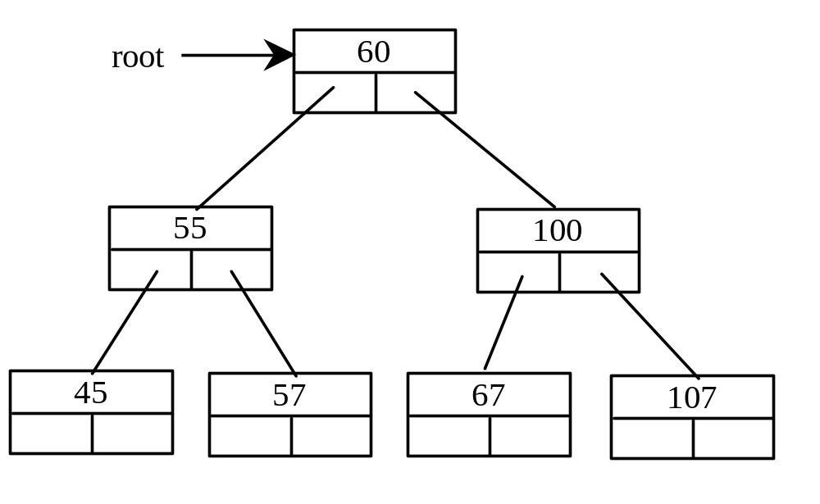
Representing Binary Trees
A binary tree can be represented using a set of linked nodes. Each node contains a value and two links named left and right that reference the left child and right child, respectively, as shown in Figure 17.2.

Slide 6
Representing a TreeNode
template<typename T>
class TreeNode
{
public:
T element; // Element contained in the node
TreeNode<T> * left; // Pointer to the left child
TreeNode<T> * right; // Pointer to the right child
TreeNode() // No-arg constructor
{
left = NULL;
right = NULL;
}
TreeNode(T element) // Constructor
{
this->element = element;
left = NULL;
right = NULL;
}
};

Slide 7
Adding Nodes
// Create the root node
TreeNode<int> *root = new TreeNode<int>(60);
// Create the left child node
root->left = new TreeNode<int>(55);
// Create the right child node
root->right = new TreeNode<int>(100);

Slide 8
Accessing Nodes in Binary Trees
// Display the root element
cout << root->element << endl;
// Display the element in the left child of the root
cout << (root->left)->element << endl;
// Display the element in the right child of the root
cout << (root->right)->element << endl;

Slide 9
Inserting an Element to a Binary Tree
If a binary tree is empty, create a root node with the new element. Otherwise, locate the parent node for the new element node. If the new element is less than the parent element, the node for the new element becomes the left child of the parent. If the new element is greater than the parent element, the node for the new element becomes the right child of the parent. Here is the algorithm:

Slide 10
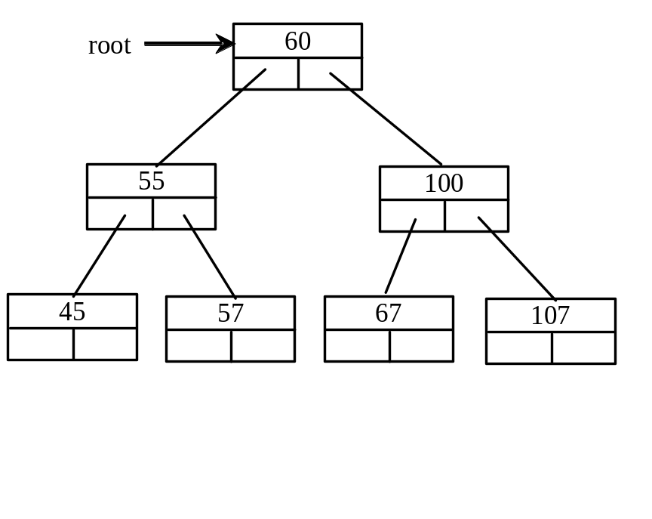
Inserting an Element to a Binary Tree
if (root == NULL)
root = new TreeNode<T>(element);
else
{
// Locate the parent node
current = root;
while (current != NULL)
if (element value < the value in current.element)
{
parent = current;
current = current->left;
}
else if (element value > the value in current.element)
{
parent = current;
current = current->right;
}
else
return false; // Duplicate node not inserted
// Create the new node and attach it to the parent node
if (element < parent->element)
parent->left = new TreeNode<T>(elemenet);
else
parent->right = new TreeNode<T>(elemenet);
return true; // Element inserted
}
Insert 101 into the following tree.

Slide 11
Trace Inserting 101 into the following tree
if (root == NULL)
root = new TreeNode<T>(element);
else
{
// Locate the parent node
current = root;
while (current != NULL)
if (element value < the value in current.element)
{
parent = current;
current = current->left;
}
else if (element value > the value in current.element)
{
parent = current;
current = current->right;
}
else
return false; // Duplicate node not inserted
// Create the new node and attach it to the parent node
if (element < parent->element)
parent->left = new TreeNode<T>(elemenet);
else
parent->right = new TreeNode<T>(elemenet);
return true; // Element inserted
}
Insert 101 into the following tree.

Slide 12
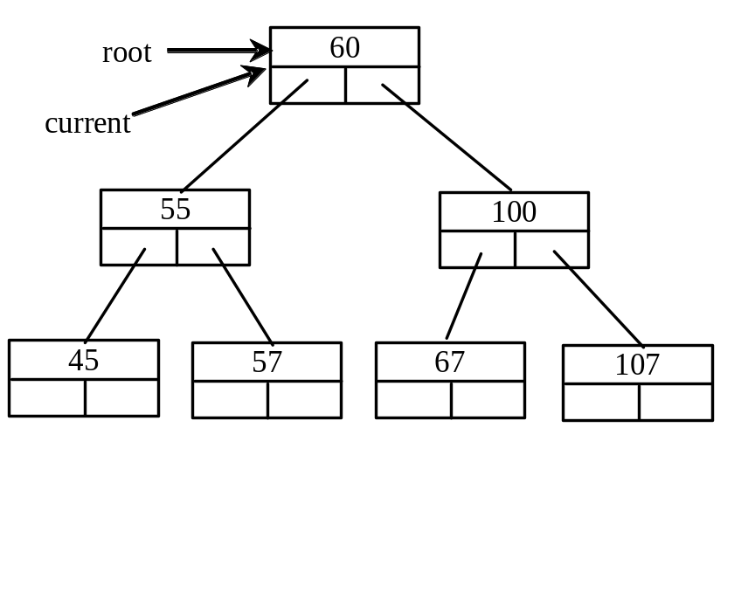
Trace Inserting 101 into the following tree, cont.
if (root == NULL)
root = new TreeNode<T>(element);
else
{
// Locate the parent node
current = root;
while (current != NULL)
if (element value < the value in current.element)
{
parent = current;
current = current->left;
}
else if (element value > the value in current.element)
{
parent = current;
current = current->right;
}
else
return false; // Duplicate node not inserted
// Create the new node and attach it to the parent node
if (element < parent->element)
parent->left = new TreeNode<T>(elemenet);
else
parent->right = new TreeNode<T>(elemenet);
return true; // Element inserted
}
Insert 101 into the following tree.

Slide 13
Trace Inserting 101 into the following tree, cont.
if (root == NULL)
root = new TreeNode<T>(element);
else
{
// Locate the parent node
current = root;
while (current != NULL)
if (element value < the value in current.element)
{
parent = current;
current = current->left;
}
else if (element value > the value in current.element)
{
parent = current;
current = current->right;
}
else
return false; // Duplicate node not inserted
// Create the new node and attach it to the parent node
if (element < parent->element)
parent->left = new TreeNode<T>(elemenet);
else
parent->right = new TreeNode<T>(elemenet);
return true; // Element inserted
}
Insert 101 into the following tree.

Slide 14
Trace Inserting 101 into the following tree, cont.
if (root == NULL)
root = new TreeNode<T>(element);
else
{
// Locate the parent node
current = root;
while (current != NULL)
if (element value < the value in current.element)
{
parent = current;
current = current->left;
}
else if (element value > the value in current.element)
{
parent = current;
current = current->right;
}
else
return false; // Duplicate node not inserted
// Create the new node and attach it to the parent node
if (element < parent->element)
parent->left = new TreeNode<T>(elemenet);
else
parent->right = new TreeNode<T>(elemenet);
return true; // Element inserted
}
Insert 101 into the following tree.
101 < 60?

Slide 15
Trace Inserting 101 into the following tree, cont.
if (root == NULL)
root = new TreeNode<T>(element);
else
{
// Locate the parent node
current = root;
while (current != NULL)
if (element value < the value in current.element)
{
parent = current;
current = current->left;
}
else if (element value > the value in current.element)
{
parent = current;
current = current->right;
}
else
return false; // Duplicate node not inserted
// Create the new node and attach it to the parent node
if (element < parent->element)
parent->left = new TreeNode<T>(elemenet);
else
parent->right = new TreeNode<T>(elemenet);
return true; // Element inserted
}
Insert 101 into the following tree.
101 > 60?

Slide 16
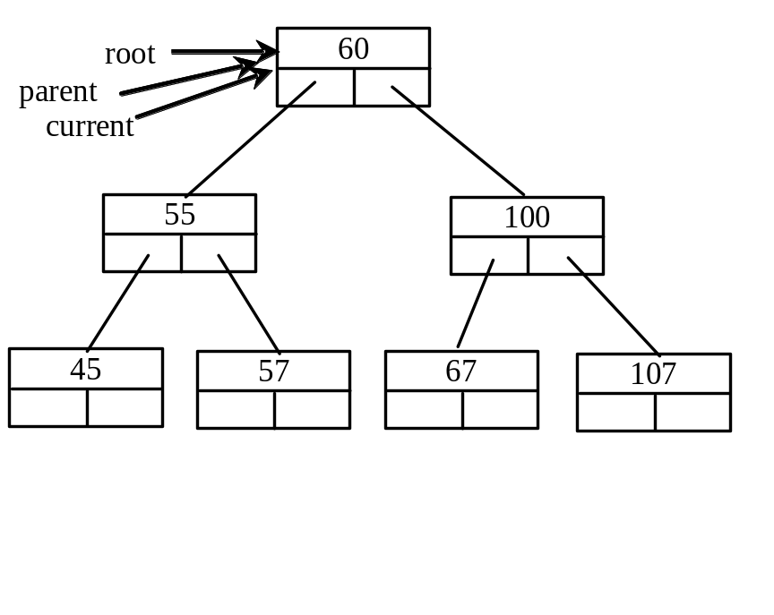
Trace Inserting 101 into the following tree, cont.
if (root == NULL)
root = new TreeNode<T>(element);
else
{
// Locate the parent node
current = root;
while (current != NULL)
if (element value < the value in current.element)
{
parent = current;
current = current->left;
}
else if (element value > the value in current.element)
{
parent = current;
current = current->right;
}
else
return false; // Duplicate node not inserted
// Create the new node and attach it to the parent node
if (element < parent->element)
parent->left = new TreeNode<T>(elemenet);
else
parent->right = new TreeNode<T>(elemenet);
return true; // Element inserted
}
Insert 101 into the following tree.
101 > 60 true

Slide 17
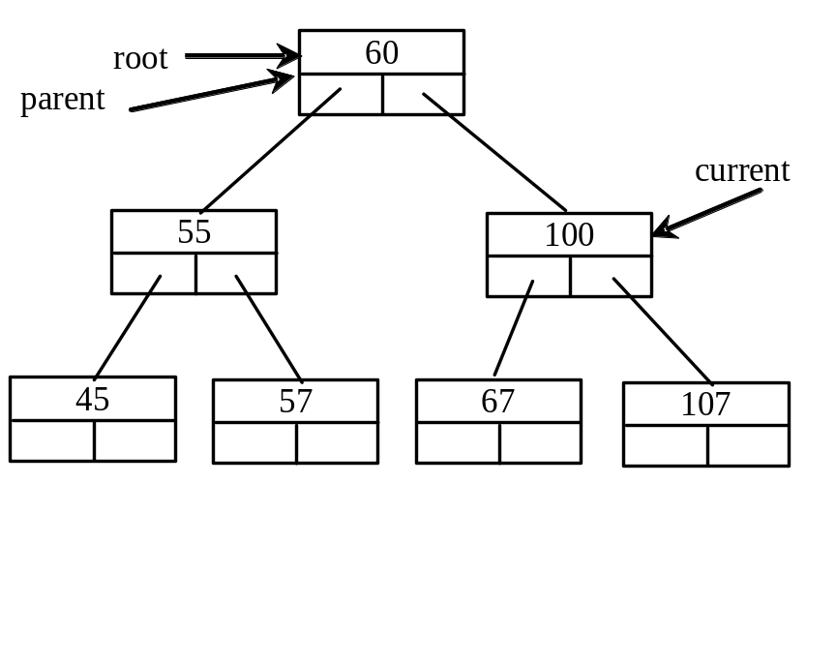
Trace Inserting 101 into the following tree, cont.
if (root == NULL)
root = new TreeNode<T>(element);
else
{
// Locate the parent node
current = root;
while (current != NULL)
if (element value < the value in current.element)
{
parent = current;
current = current->left;
}
else if (element value > the value in current.element)
{
parent = current;
current = current->right;
}
else
return false; // Duplicate node not inserted
// Create the new node and attach it to the parent node
if (element < parent->element)
parent->left = new TreeNode<T>(elemenet);
else
parent->right = new TreeNode<T>(elemenet);
return true; // Element inserted
}
Insert 101 into the following tree.
101 > 60 true

Slide 18
Trace Inserting 101 into the following tree, cont.
if (root == NULL)
root = new TreeNode<T>(element);
else
{
// Locate the parent node
current = root;
while (current != NULL)
if (element value < the value in current.element)
{
parent = current;
current = current->left;
}
else if (element value > the value in current.element)
{
parent = current;
current = current->right;
}
else
return false; // Duplicate node not inserted
// Create the new node and attach it to the parent node
if (element < parent->element)
parent->left = new TreeNode<T>(elemenet);
else
parent->right = new TreeNode<T>(elemenet);
return true; // Element inserted
}
Insert 101 into the following tree.
101 > 60 true

Slide 19
Trace Inserting 101 into the following tree, cont.
if (root == NULL)
root = new TreeNode<T>(element);
else
{
// Locate the parent node
current = root;
while (current != NULL)
if (element value < the value in current.element)
{
parent = current;
current = current->left;
}
else if (element value > the value in current.element)
{
parent = current;
current = current->right;
}
else
return false; // Duplicate node not inserted
// Create the new node and attach it to the parent node
if (element < parent->element)
parent->left = new TreeNode<T>(elemenet);
else
parent->right = new TreeNode<T>(elemenet);
return true; // Element inserted
}
Insert 101 into the following tree.
101 > 100 false

Slide 20
Trace Inserting 101 into the following tree, cont.
if (root == NULL)
root = new TreeNode<T>(element);
else
{
// Locate the parent node
current = root;
while (current != NULL)
if (element value < the value in current.element)
{
parent = current;
current = current->left;
}
else if (element value > the value in current.element)
{
parent = current;
current = current->right;
}
else
return false; // Duplicate node not inserted
// Create the new node and attach it to the parent node
if (element < parent->element)
parent->left = new TreeNode<T>(elemenet);
else
parent->right = new TreeNode<T>(elemenet);
return true; // Element inserted
}
Insert 101 into the following tree.
101 > 100 true

Slide 21
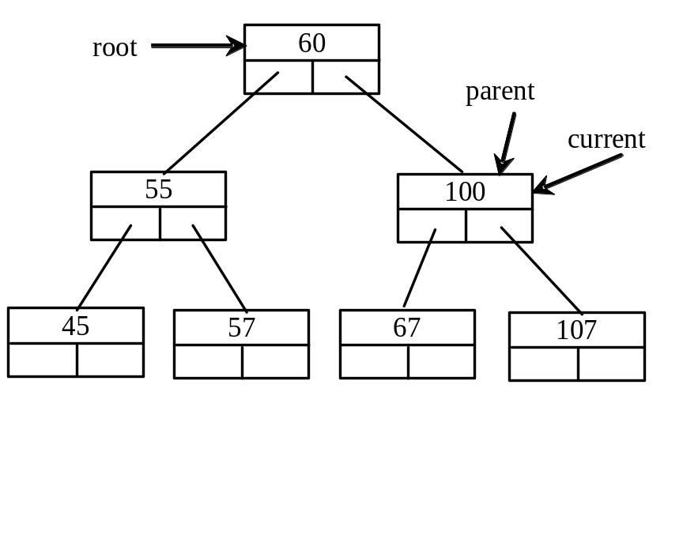
Trace Inserting 101 into the following tree, cont.
if (root == NULL)
root = new TreeNode<T>(element);
else
{
// Locate the parent node
current = root;
while (current != NULL)
if (element value < the value in current.element)
{
parent = current;
current = current->left;
}
else if (element value > the value in current.element)
{
parent = current;
current = current->right;
}
else
return false; // Duplicate node not inserted
// Create the new node and attach it to the parent node
if (element < parent->element)
parent->left = new TreeNode<T>(elemenet);
else
parent->right = new TreeNode<T>(elemenet);
return true; // Element inserted
}
Insert 101 into the following tree.
101 > 100 true

Slide 22
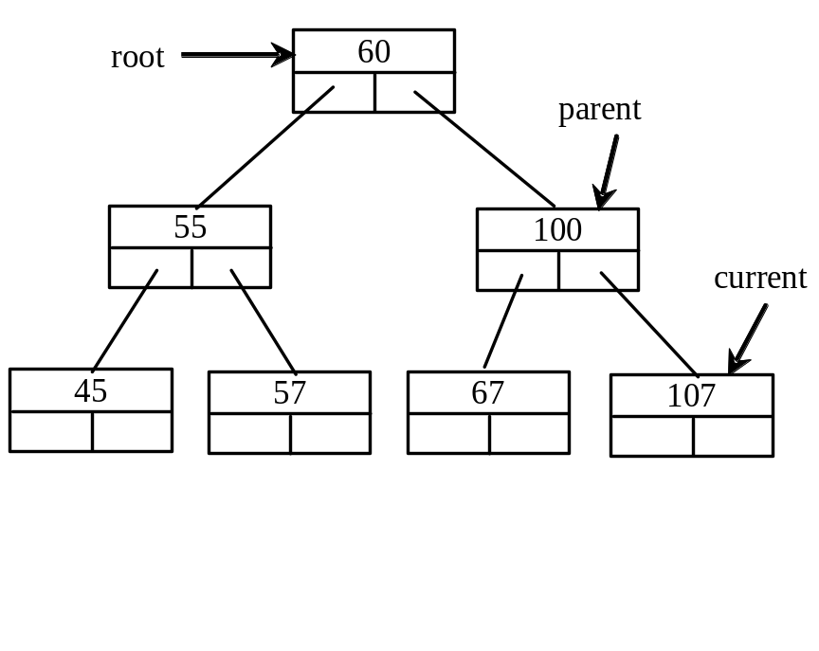
Trace Inserting 101 into the following tree, cont.
if (root == NULL)
root = new TreeNode<T>(element);
else
{
// Locate the parent node
current = root;
while (current != NULL)
if (element value < the value in current.element)
{
parent = current;
current = current->left;
}
else if (element value > the value in current.element)
{
parent = current;
current = current->right;
}
else
return false; // Duplicate node not inserted
// Create the new node and attach it to the parent node
if (element < parent->element)
parent->left = new TreeNode<T>(elemenet);
else
parent->right = new TreeNode<T>(elemenet);
return true; // Element inserted
}
Insert 101 into the following tree.
101 > 100 true

Slide 23
Trace Inserting 101 into the following tree, cont.
if (root == NULL)
root = new TreeNode<T>(element);
else
{
// Locate the parent node
current = root;
while (current != NULL)
if (element value < the value in current.element)
{
parent = current;
current = current->left;
}
else if (element value > the value in current.element)
{
parent = current;
current = current->right;
}
else
return false; // Duplicate node not inserted
// Create the new node and attach it to the parent node
if (element < parent->element)
parent->left = new TreeNode<T>(elemenet);
else
parent->right = new TreeNode<T>(elemenet);
return true; // Element inserted
}
Insert 101 into the following tree.
101 > 100 true

Slide 24
Trace Inserting 101 into the following tree, cont.
if (root == NULL)
root = new TreeNode<T>(element);
else
{
// Locate the parent node
current = root;
while (current != NULL)
if (element value < the value in current.element)
{
parent = current;
current = current->left;
}
else if (element value > the value in current.element)
{
parent = current;
current = current->right;
}
else
return false; // Duplicate node not inserted
// Create the new node and attach it to the parent node
if (element < parent->element)
parent->left = new TreeNode<T>(elemenet);
else
parent->right = new TreeNode<T>(elemenet);
return true; // Element inserted
}
Insert 101 into the following tree.
101 < 107 true

Slide 25
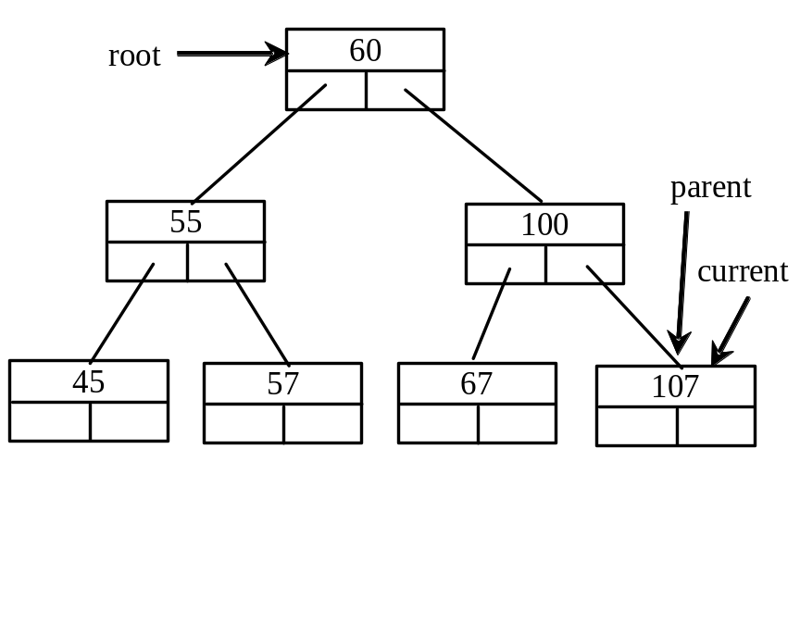
Trace Inserting 101 into the following tree, cont.
if (root == NULL)
root = new TreeNode<T>(element);
else
{
// Locate the parent node
current = root;
while (current != NULL)
if (element value < the value in current.element)
{
parent = current;
current = current->left;
}
else if (element value > the value in current.element)
{
parent = current;
current = current->right;
}
else
return false; // Duplicate node not inserted
// Create the new node and attach it to the parent node
if (element < parent->element)
parent->left = new TreeNode<T>(elemenet);
else
parent->right = new TreeNode<T>(elemenet);
return true; // Element inserted
}
Insert 101 into the following tree.
101 < 107 true

Slide 26
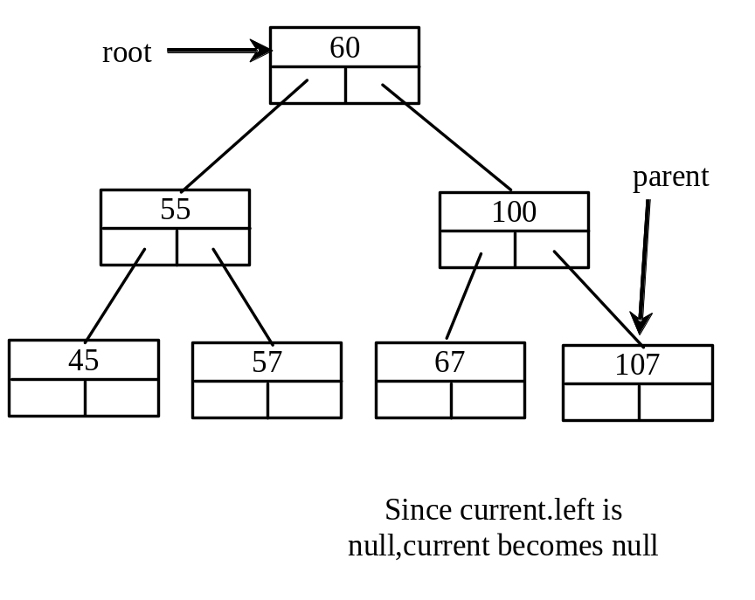
Trace Inserting 101 into the following tree, cont.
if (root == NULL)
root = new TreeNode<T>(element);
else
{
// Locate the parent node
current = root;
while (current != NULL)
if (element value < the value in current.element)
{
parent = current;
current = current->left;
}
else if (element value > the value in current.element)
{
parent = current;
current = current->right;
}
else
return false; // Duplicate node not inserted
// Create the new node and attach it to the parent node
if (element < parent->element)
parent->left = new TreeNode<T>(elemenet);
else
parent->right = new TreeNode<T>(elemenet);
return true; // Element inserted
}
Insert 101 into the following tree.
101 < 107 true

Slide 27
Trace Inserting 101 into the following tree, cont.
if (root == NULL)
root = new TreeNode<T>(element);
else
{
// Locate the parent node
current = root;
while (current != NULL)
if (element value < the value in current.element)
{
parent = current;
current = current->left;
}
else if (element value > the value in current.element)
{
parent = current;
current = current->right;
}
else
return false; // Duplicate node not inserted
// Create the new node and attach it to the parent node
if (element < parent->element)
parent->left = new TreeNode<T>(elemenet);
else
parent->right = new TreeNode<T>(elemenet);
return true; // Element inserted
}
Insert 101 into the following tree.
current is null now

Slide 28
Trace Inserting 101 into the following tree, cont.
if (root == NULL)
root = new TreeNode<T>(element);
else
{
// Locate the parent node
current = root;
while (current != NULL)
if (element value < the value in current.element)
{
parent = current;
current = current->left;
}
else if (element value > the value in current.element)
{
parent = current;
current = current->right;
}
else
return false; // Duplicate node not inserted
// Create the new node and attach it to the parent node
if (element < parent->element)
parent->left = new TreeNode<T>(elemenet);
else
parent->right = new TreeNode<T>(elemenet);
return true; // Element inserted
}
Insert 101 into the following tree.
101 < 107 true

Slide 29
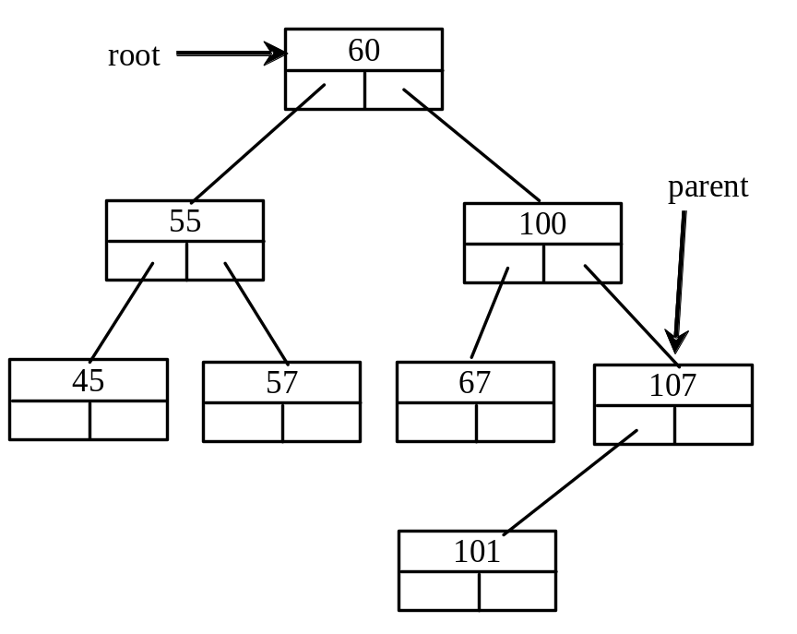
Trace Inserting 101 into the following tree, cont.
if (root == NULL)
root = new TreeNode<T>(element);
else
{
// Locate the parent node
current = root;
while (current != NULL)
if (element value < the value in current.element)
{
parent = current;
current = current->left;
}
else if (element value > the value in current.element)
{
parent = current;
current = current->right;
}
else
return false; // Duplicate node not inserted
// Create the new node and attach it to the parent node
if (element < parent->element)
parent->left = new TreeNode<T>(elemenet);
else
parent->right = new TreeNode<T>(elemenet);
return true; // Element inserted
}
Insert 101 into the following tree.
101 < 107 true

Slide 30
Trace Inserting 101 into the following tree, cont.
if (root == NULL)
root = new TreeNode<T>(element);
else
{
// Locate the parent node
current = root;
while (current != NULL)
if (element value < the value in current.element)
{
parent = current;
current = current->left;
}
else if (element value > the value in current.element)
{
parent = current;
current = current->right;
}
else
return false; // Duplicate node not inserted
// Create the new node and attach it to the parent node
if (element < parent->element)
parent->left = new TreeNode<T>(elemenet);
else
parent->right = new TreeNode<T>(elemenet);
return true; // Element inserted
}
Insert 101 into the following tree.
101 < 107 true

Slide 31
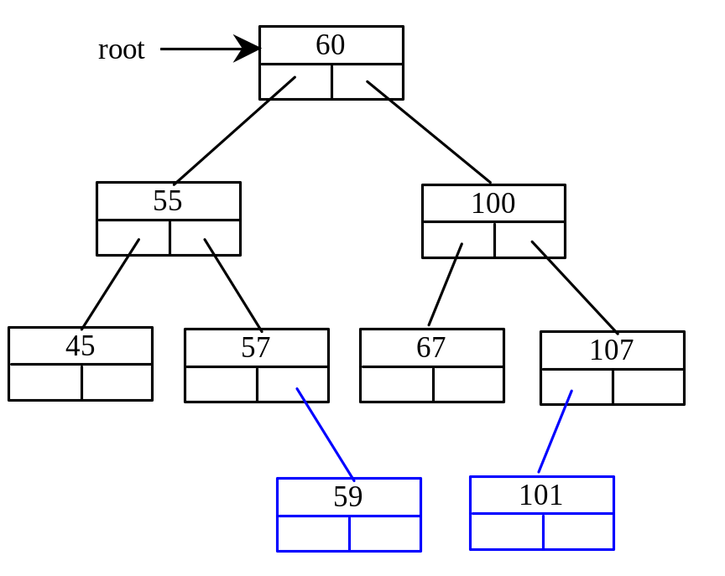
Inserting 59 into the Tree
if (root == NULL)
root = new TreeNode<T>(element);
else
{
// Locate the parent node
current = root;
while (current != NULL)
if (element value < the value in current.element)
{
parent = current;
current = current->left;
}
else if (element value > the value in current.element)
{
parent = current;
current = current->right;
}
else
return false; // Duplicate node not inserted
// Create the new node and attach it to the parent node
if (element < parent->element)
parent->left = new TreeNode<T>(elemenet);
else
parent->right = new TreeNode<T>(elemenet);
return true; // Element inserted
}

Slide 32
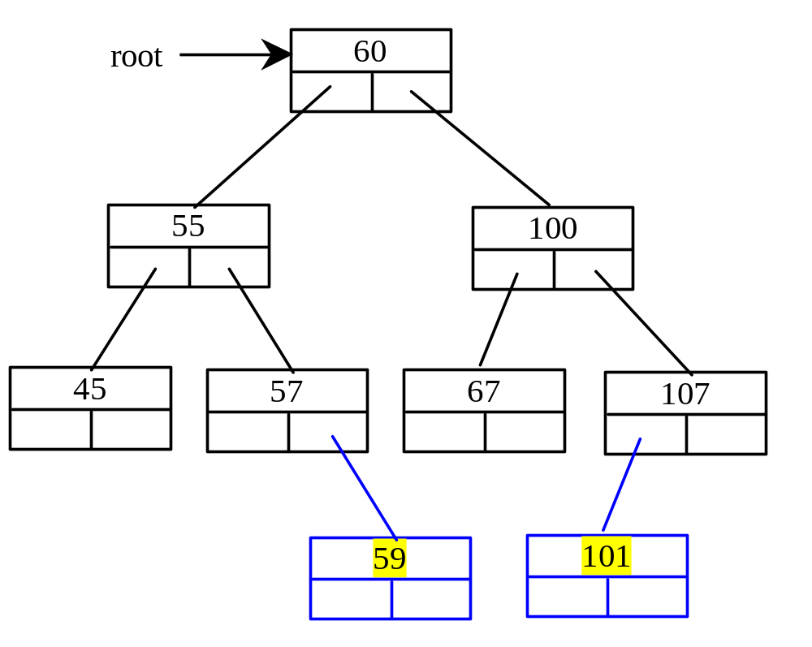
Inserting an Element into a Binary Search Tree

Slide 33
Tree Traversal
Tree traversal is the process of visiting each node in the tree exactly once in certain order. There are several ways to traverse a tree. This section presents inorder, preorder, postorder, depth-first, and breadth-first traversals.

Slide 34
Inorder Traversal
With inorder traversal, the left subtree of the current node is visited first, then the current node, and finally the right subtree of the current node. The inorder traversal displays all the nodes in a binary search tree in increasing order.

Slide 35
Postorder Traversal
With postorder traversal, the left subtree of the current node is visited first, then the right subtree of the current node, and finally the current node itself.

Slide 36
Preorder Traversal
With preorder traversal, the current node is visited first, then the left subtree of the current node, and finally the right subtree of the current node. Depth-first traversal is the same as preorder traversal.

Slide 37
breadth-first Traversal
With breadth-first traversal, the nodes are visited level by level. First the root is visited, then all the children of the root from left to right, then the grandchildren of the root from left to right, and so on.

Slide 38
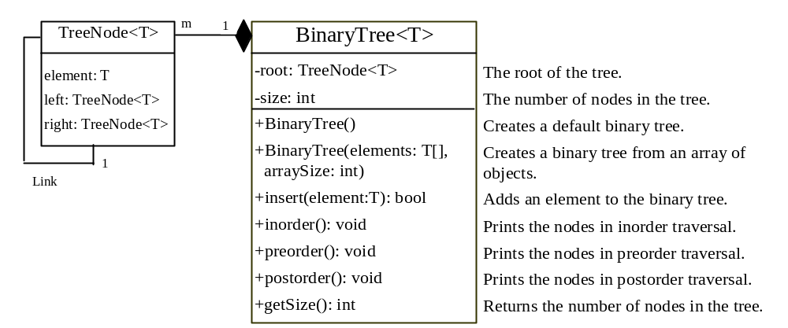
The BinaryTree Class
BinaryTree
TestBinaryTree
Run

Slide 39
Heaps
Heap is a useful data structure for designing efficient sorting algorithms and priority queues. A heap is a binary tree with the following properties:
It is a complete binary tree.
Each node is greater than or equal to any of its children.

Slide 40
complete binary tree
A binary tree is complete if every level of the tree is full except that the last level may not be full and all the leaves on the last level are placed left-most. For example, in Figure 17.6, the binary trees in (a) and (b) are complete, but the binary trees in (c) and (d) are not complete. Further, the binary tree in (a) is a heap, but the binary tree in (b) is not a heap, because the root (39) is less than its right child (42).

Slide 41
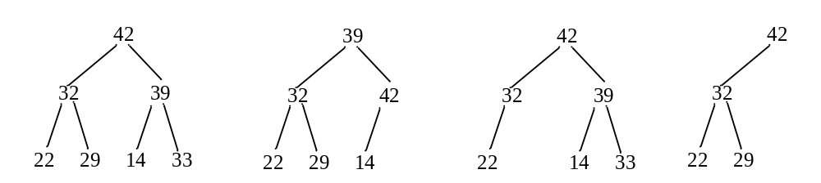
complete binary tree

Slide 42
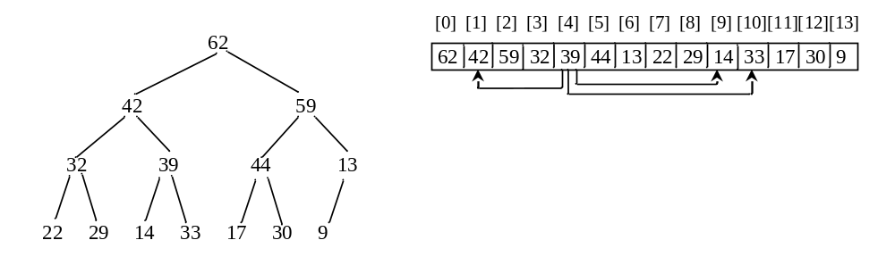
Representing a Heap
A heap is a binary tree. So it can be represented using a binary tree data structure. However, a more efficient representation for a heap is using an array or a vector if the heap size is known in advance.

Slide 43
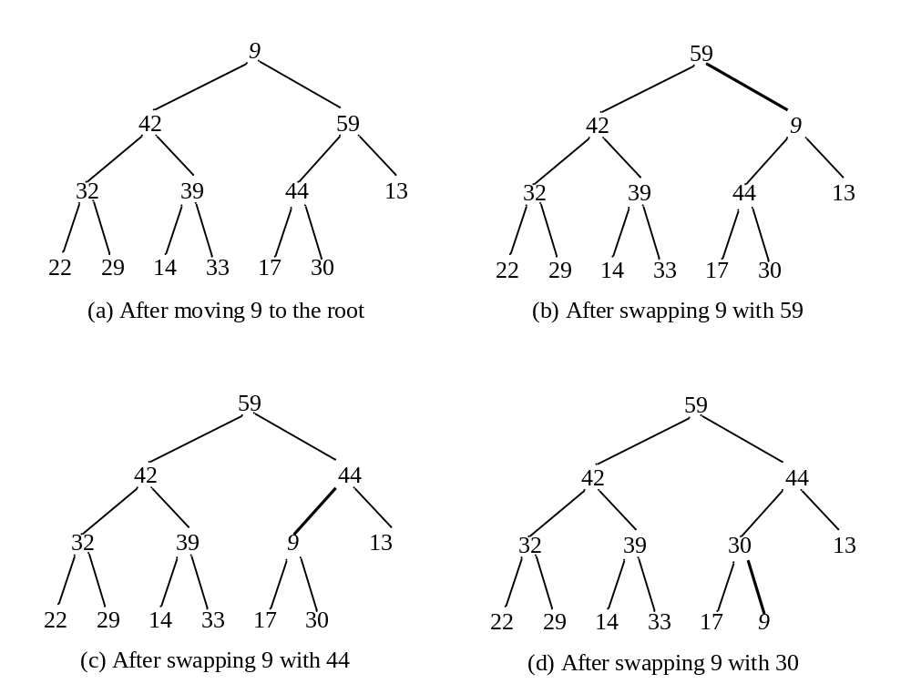
Removing the Root

Slide 44
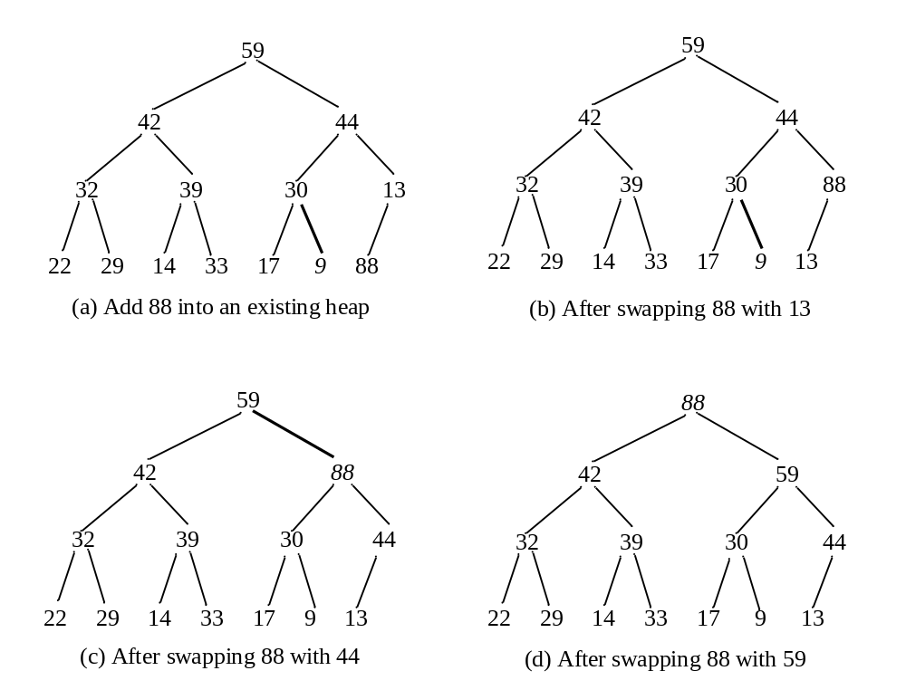
Adding a New Node

Slide 45
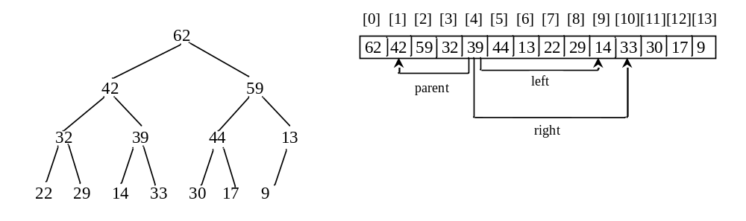
Representing a Heap
For a node at position i, its left child is at position 2i+1 and its right child is at position 2i+2, and its parent is (i-1)/2. For example, the node for element 39 is at position 4, so its left child (element 14) is at 9 (2*4+1), its right child (element 33) is at 10 (2*4+2), and its parent (element 42) is at 1 ((4-1)/2).

Slide 46
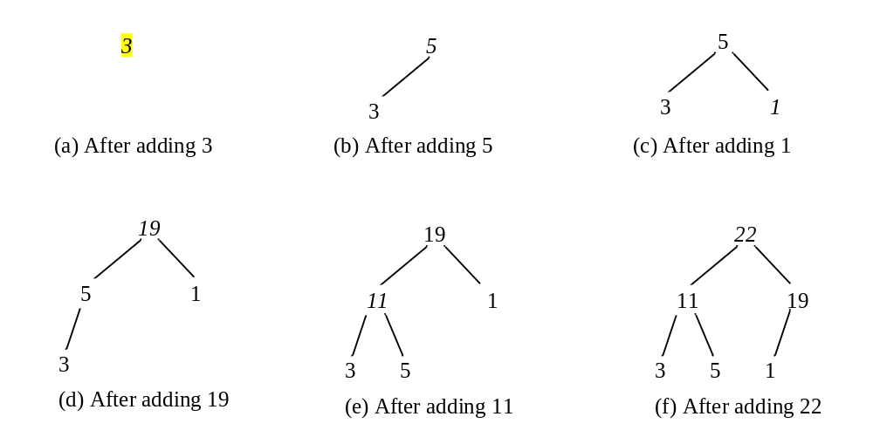
Adding Elements to the Heap
Adding 3, 5, 1, 19, 11, and 22 to a heap, initially empty

Slide 47
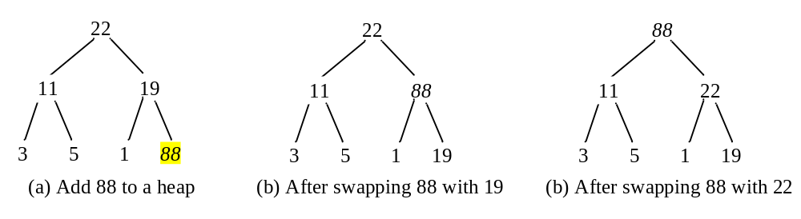
Rebuild the heap after adding a new node
Adding 88 to the heap

Slide 48
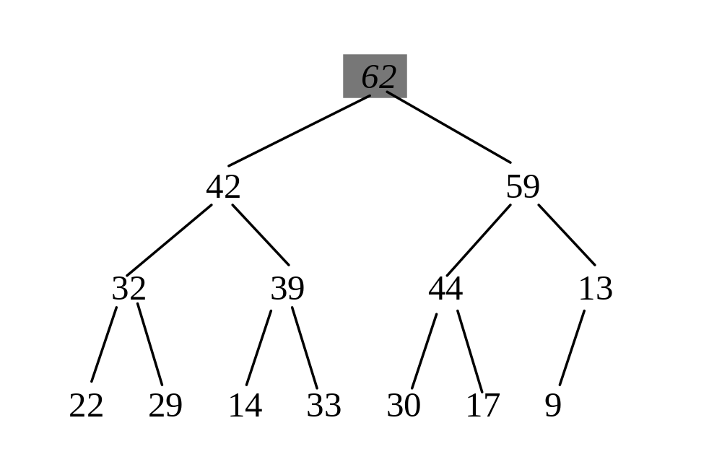
Removing the Root and Rebuild the Tree
Removing root 62 from the heap

Slide 49
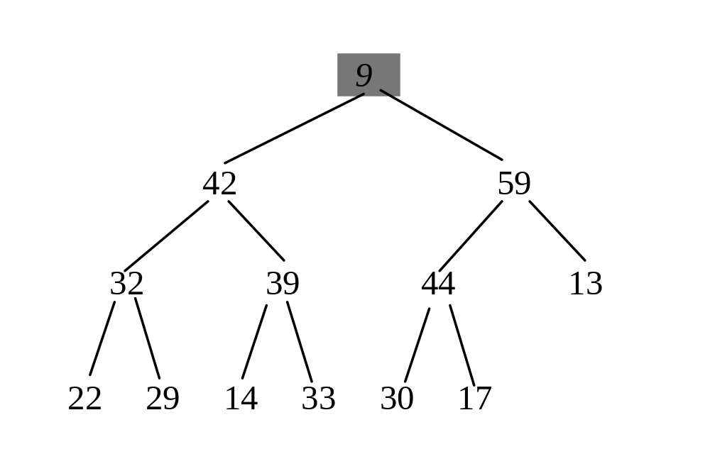
Removing the Root and Rebuild the Tree
Move 9 to root

Slide 50
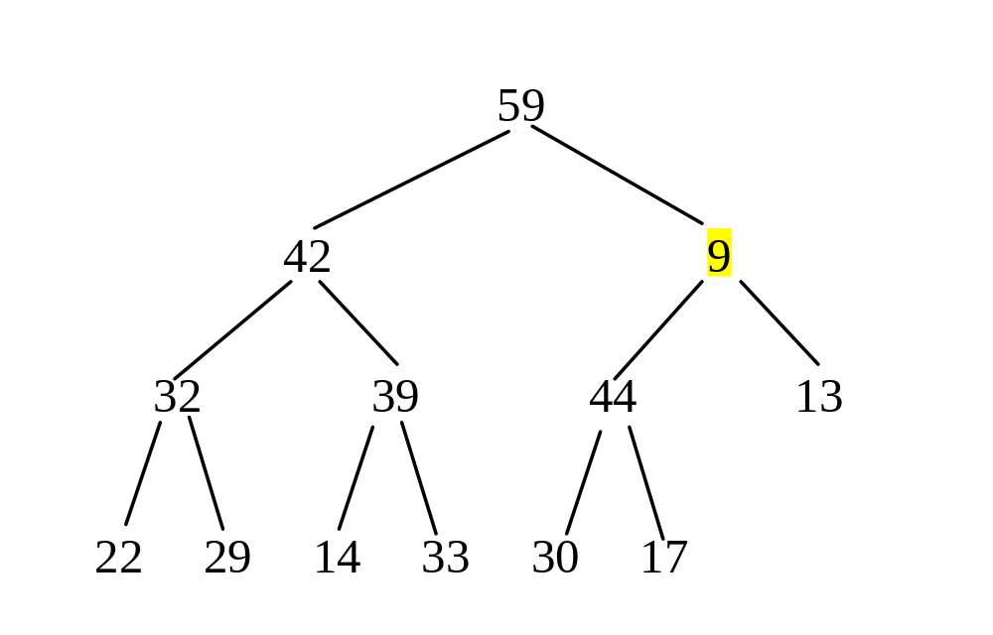
Removing the Root and Rebuild the Tree
Swap 9 with 59

Slide 51
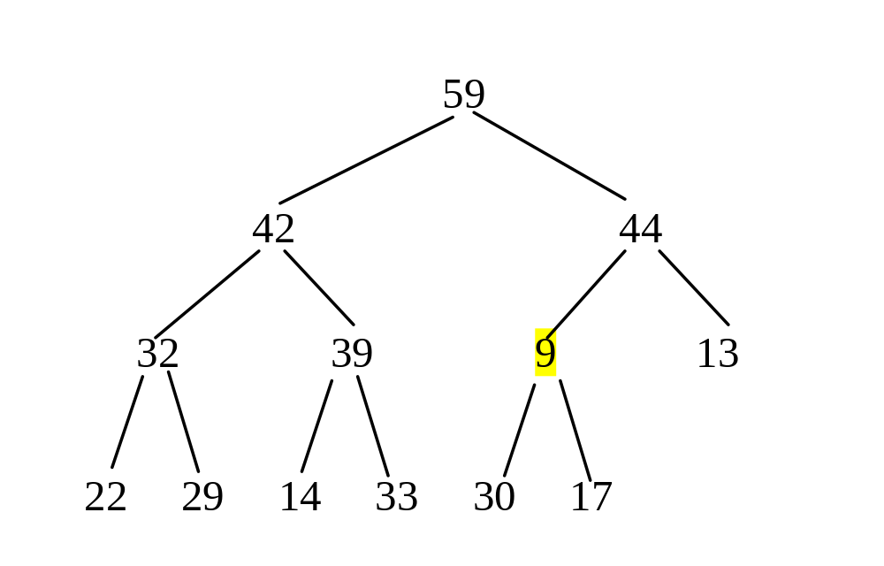
Removing the Root and Rebuild the Tree
Swap 9 with 44

Slide 52
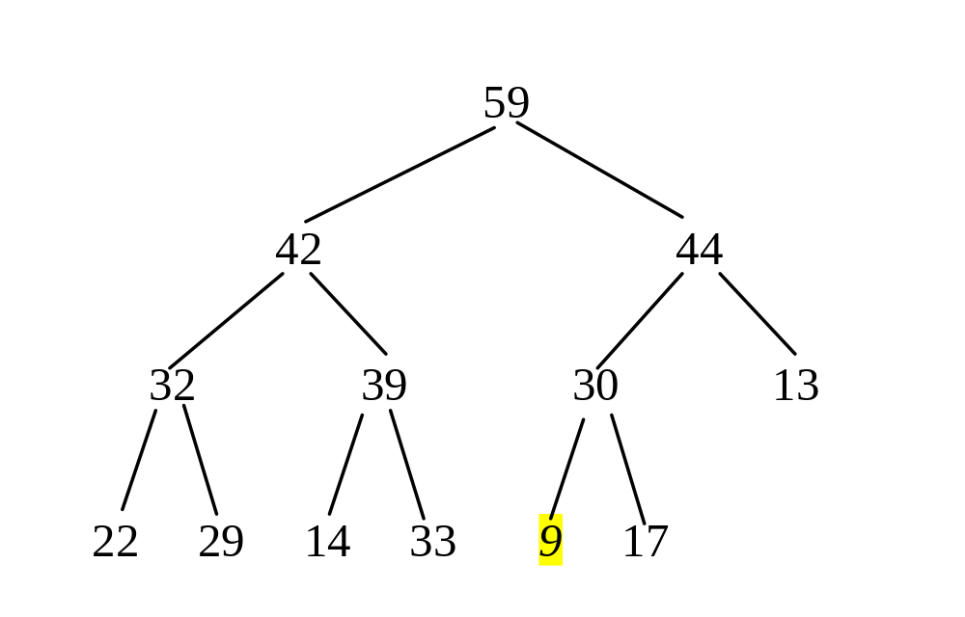
Removing the Root and Rebuild the Tree
Swap 9 with 30

Slide 53
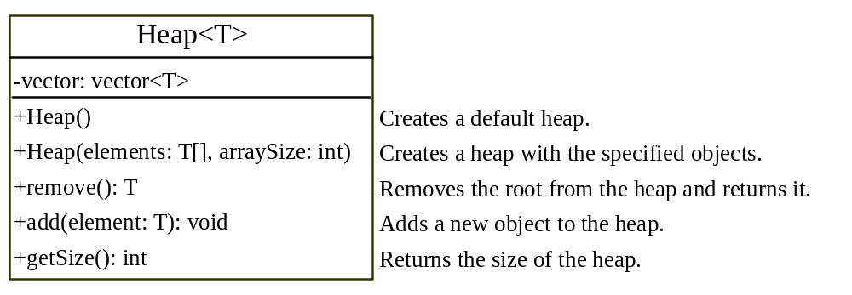
The Heap Class
Heap
TestHeap
Run

Slide 54
Priority Queues
A regular queue is a first-in and first-out data structure. Elements are appended to the end of the queue and are removed from the beginning of the queue. In a priority queue, elements are assigned with priorities. The element with the highest priority is accessed or removed first. A priority queue has a largest-in, first-out behavior. For example, the emergency room in a hospital assigns patients with priority numbers; the patient with the highest priority is treated first.

Slide 55
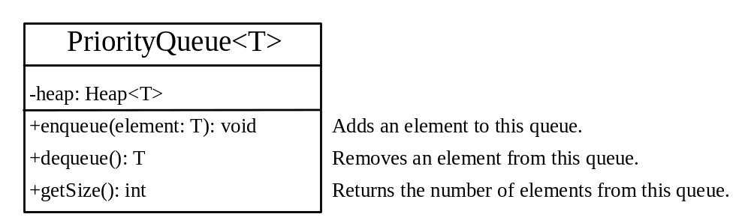
Priority Queues
PriorityQueue
TestPriorityQueue
Run

